Slide 1
LeakWatch
Progress & Plan
Machine Learning for Water-Leak Detection, Localization, and Response

Slide 2
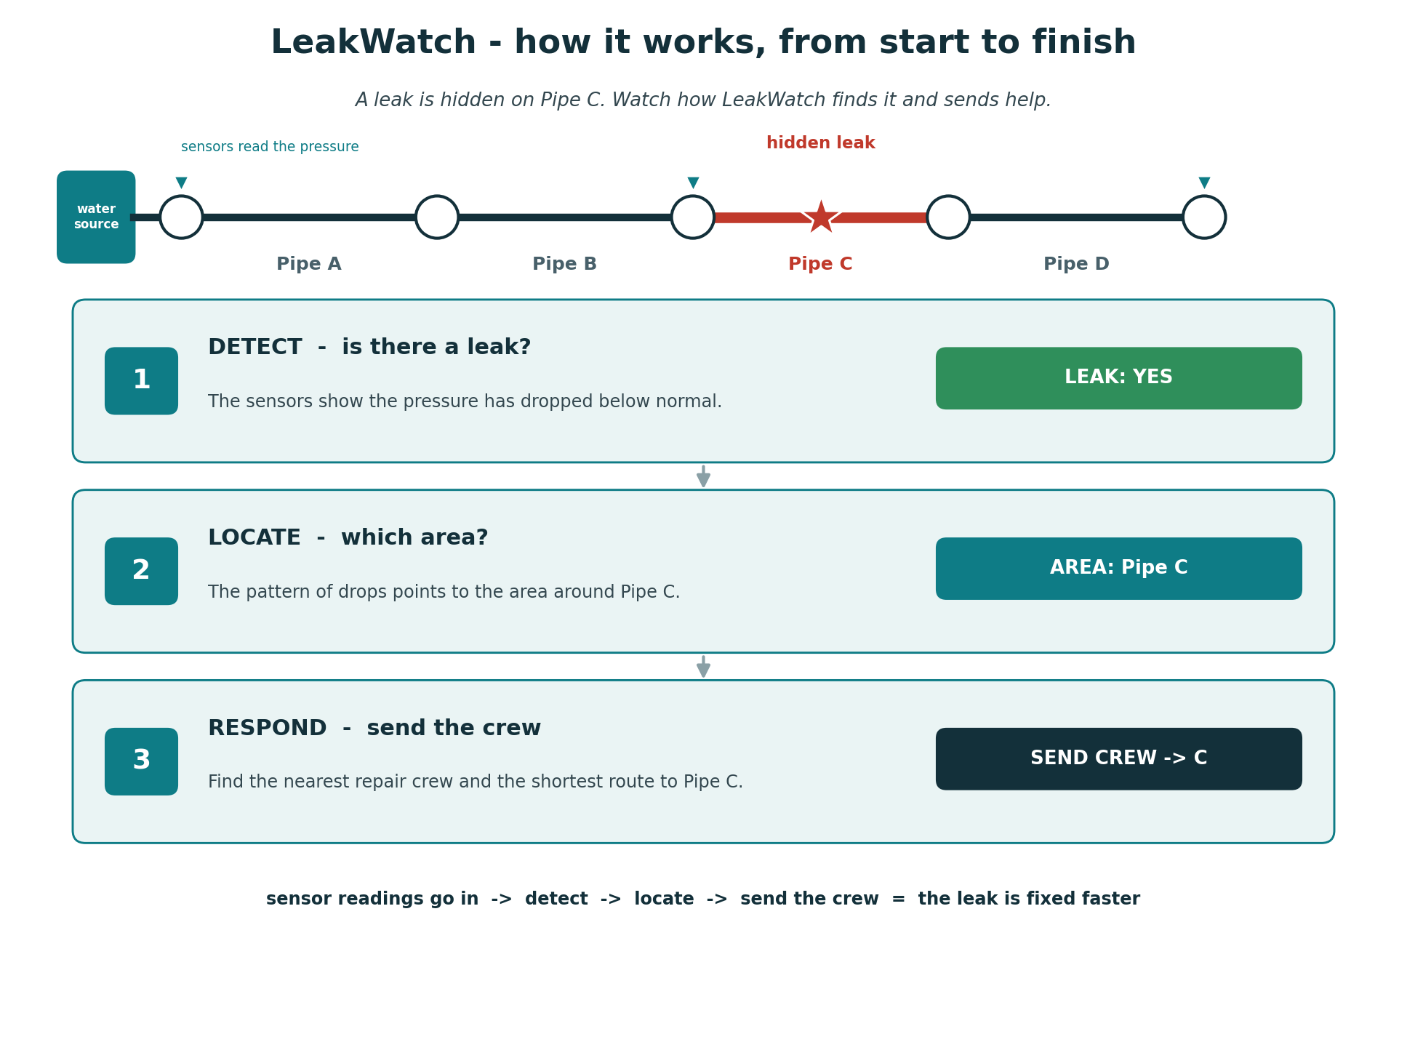
WHAT THE APPLICATION DOES
The project in one picture
2

Slide 3
THE MACHINE LEARNING
The models I use
Detection model
1
A Random Forest that answers: is there a leak? (yes / no)
Localization model
2
A Random Forest that answers: which area is the leak in?
Response routing (not a model)
3
A shortest-path calculation: nearest crew + route
3

Slide 4
THE RESPONSE STEP
The crew-dispatch step
WHAT IT IS
The last step of my project. After the model finds the leak's area, this step decides which repair crew to send and by what route. It is a plain calculation, NOT machine learning.
WHAT I WILL DO (build it)
Turn the pipe network into a map of connections (junctions joined by pipes, each with a length). Mark a few junctions as repair-crew home bases. Then use a shortest-path tool (NetworkX) to measure the distance from each base to the leak.
WHAT IT WILL DO (the output)
Take the leak area from the model, find the CLOSEST crew, and print a clear instruction: "send this crew, follow this route, it is this many meters." So the leak can be reached and fixed faster.
Simple way to picture it: like a delivery app - once it knows WHERE the order is, it finds the NEAREST driver and the SHORTEST route.
4

Slide 5
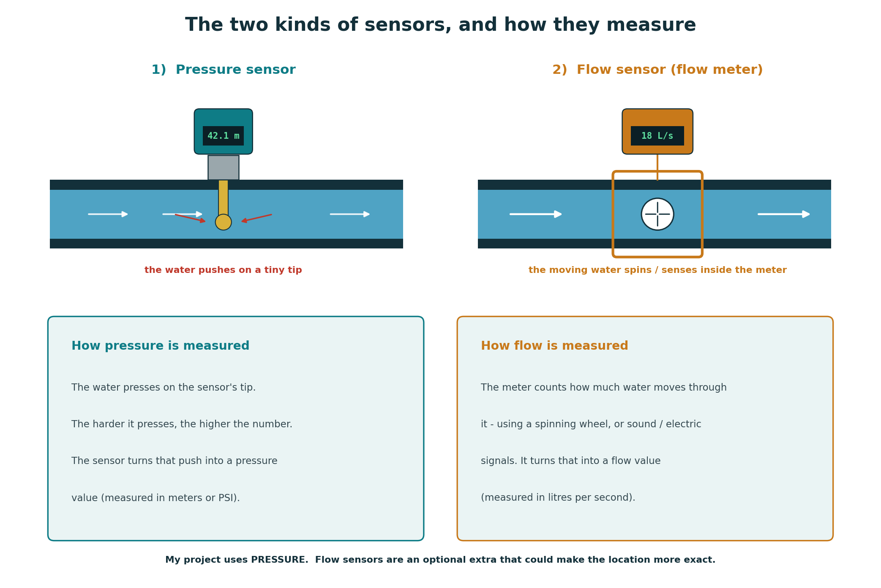
THE HARDWARE
What a sensor is
5

Slide 6
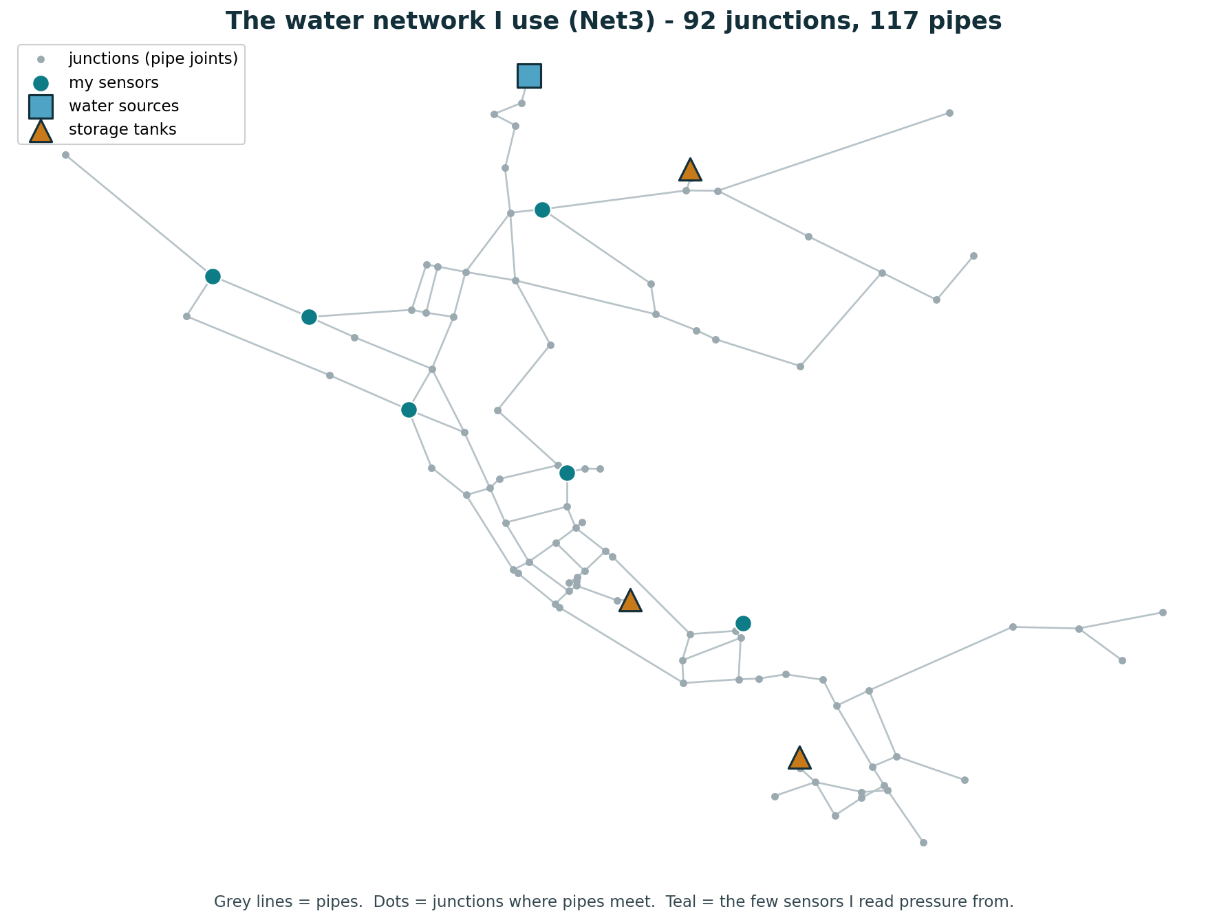
THE DATA SOURCE
The water network I use (Net3)
6

Slide 7
PROJECT BREAKDOWN
Application features
1
Data generation
Simulate the network and create labeled sensor data with leaks I place.
2
Leak detection
Read the sensor pressure and decide whether there is a leak.
3
Leak localization
Work out which area of the network the leak is in.
4
Response routing
Pick the nearest repair crew and the shortest route.
5
Results dashboard
Show the leak, the route, and the accuracy in one clear view.
7

Slide 8
WHERE I AM NOW
My progress so far
Here is what I have built and run in my notebook up to now:
Set up the environment
loaded the water network and the tools (WNTR, scikit-learn)
DONE
Generated my own data
simulated many leaks and built a labeled table (588 rows)
DONE
Built the residual feature
turned raw pressure into the drop-from-normal at each sensor
DONE
Trained the detection model
a Random Forest that learns leak vs no-leak from the data
DONE
Next step: measure the model's accuracy, then build the localization model (which area).
8

